Slide 1
Simple Linear Regression
By Zoya akbar

Slide 2
Dataset Description
Total bill
Tip
Sex
Smoker
Day
Time
size

Slide 3
Project Objectives
1. Understanding the Dataset:
• Carefully examine the dataset containing the dependent and independent variables.
• Ensure that the dataset is clean and doesn't contain any missing values or outliers.
2. Data Visualization:
• Visualize the relationship between the independent and dependent variables using scatter plots.
• Look for any patterns or trends that may exist in the data.

Slide 4
Project Objectives
3. Model Building:
• Split the dataset into training and testing sets.
• Use libraries like scikit-learn to build a simple linear regression model.
4. Model Evaluation:
• Evaluate the model's performance using metrics such as Mean Squared Error (MSE) or
R-squared.
• Compare the predicted values with the actual values to assess the model's accuracy.

Slide 5
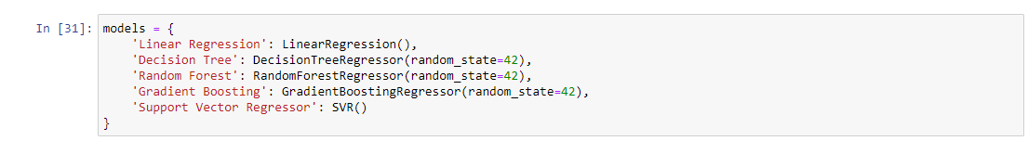
Analysis

Slide 6
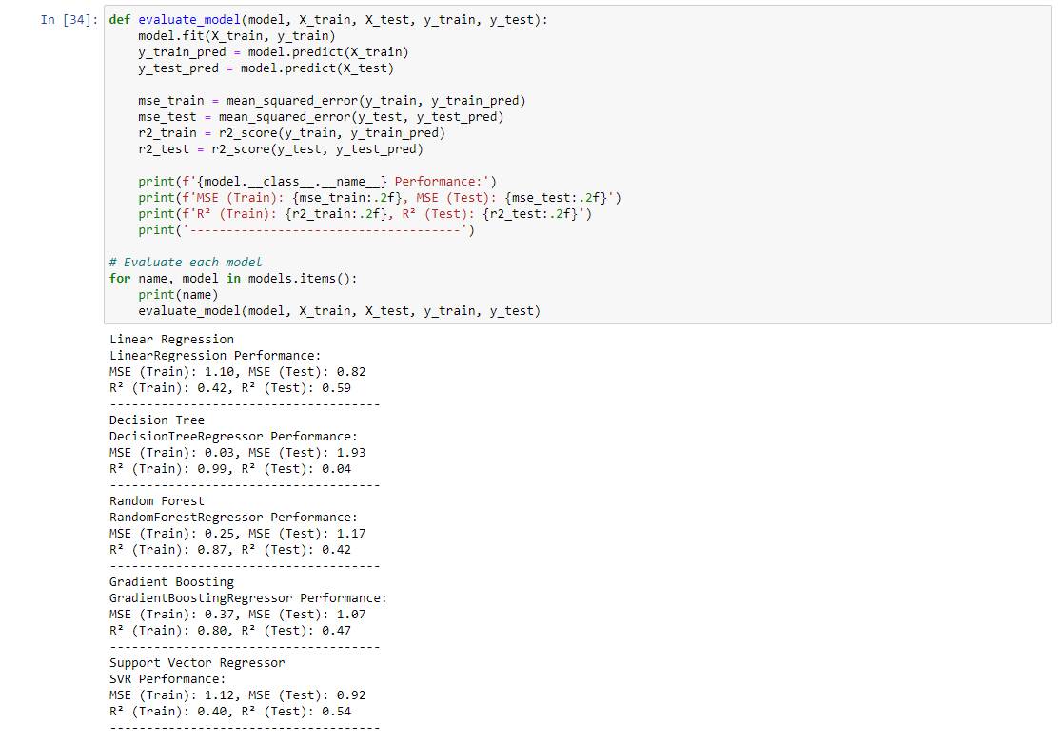
Analysis

Slide 7
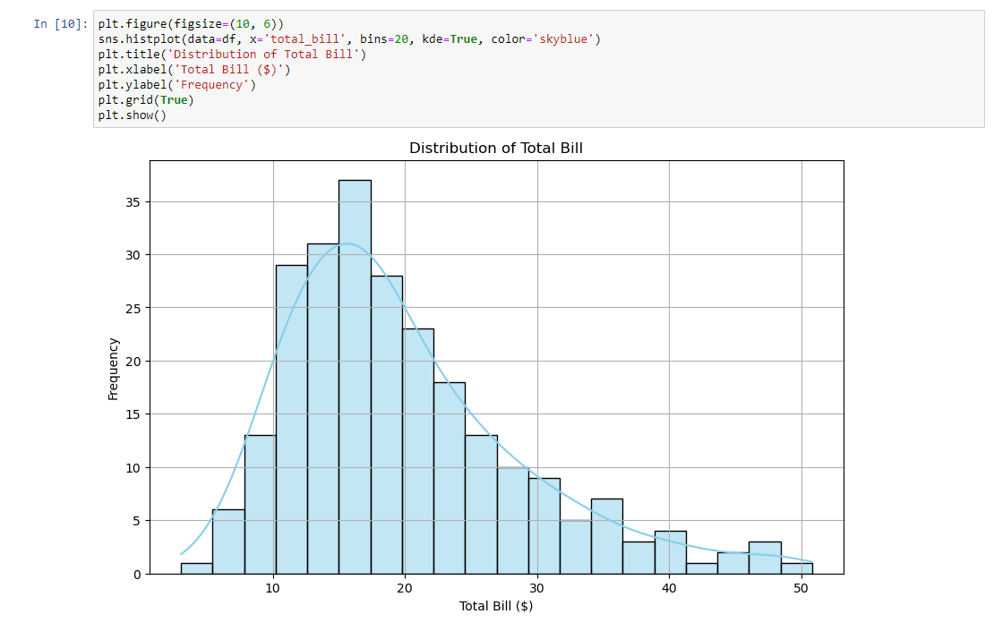
Exploratory Data Analysis

Slide 8
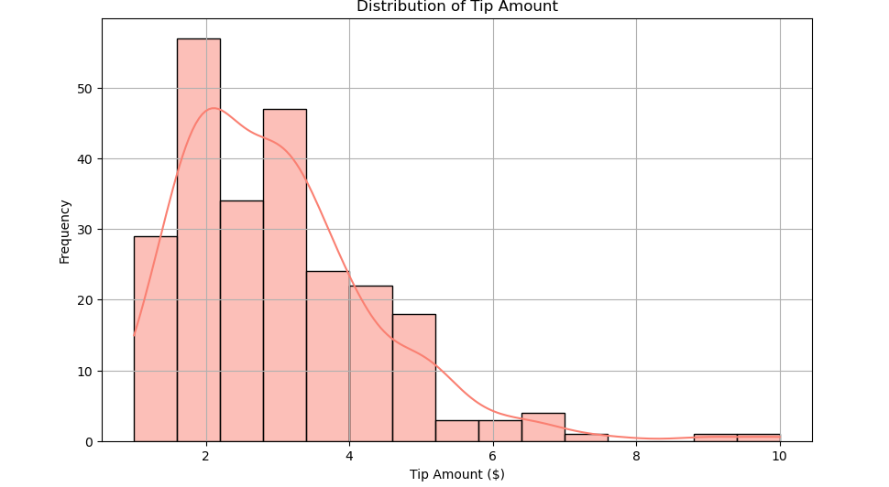
Exploratory Data Analysis

